Slide 1
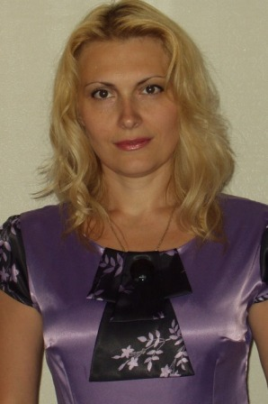
Lecturer - Fedotova Iryna Volodymyrivna Professor of the Department of Management, Doctor of economics, Associate professor
selective educational component
«SELF-MANAGEMENT»
The scope of the discipline - 4 credits
Final control - credit
Lectures - 16 hours
Practical classes - 16 hours
Independent work - 88 hours

Slide 2
The main tasks of studying the academic discipline are: - formation of the students' combination of knowledge, skills and ideas on the theoretical and methodical foundations of self-management; - determination of personal values and goals of the manager; - management of personal self-development; - development of effective management skills; - organization of managerial activities of different levels managers; - application of modern principles and directions of the scientific organization of the manager's activity.
THE GOAL is the training of specialists for professional activity in management issues at modern enterprises, in particular, using methods of self-management, self-organization, formation of motivation for personal and professional success.
PROGRAM LEARNING OUTCOMES:
1. Preserve moral, cultural, scientific values and increase the achievements of society, use various types and forms of physical activity to lead a healthy lifestyle.
2. Demonstrate knowledge of theories, methods and functions of management, modern concepts of leadership.
3. Demonstrate skills in identifying problems and justifying management decisions.
4. Demonstrate interaction, leadership and teamwork skills.
5. Have the skills to justify effective tools for motivating the organization's personnel.
6. Demonstrate the skills of situation analysis and communication in various areas of the organization.
7. Identify the causes of stress, adapt yourself and team members to a stressful situation, find means to neutralize it.
8. Demonstrate the ability to act socially responsibly and socially conscious on the basis of ethical considerations (motives), respect for diversity and interculturality.
9. Demonstrate the skills of independent work, flexible thinking, openness to new knowledge, be critical and self-critical.

